Slide 1

Deriving Alpha from News
Ty Painter
Andrew Chin, Quantitative Research and Chief Data Scientist
Michael Li, Quantitative Associate

Slide 2
Objective & Summary
Run NLP sentiment analysis on financial news to predict the alpha of stocks
Gather news data from database
Collect news article contents
Apply NLP sentiment analysis to retrieve sentiment scores
Analyze how sentiment scores relate to stock price movements
*Alpha refers to excess returns earned on an investment above the benchmark return*

Slide 3

Data
GDELT 2.0 Event Database
Gather 15-minute files for all of 2021
Filtered for 3 columns
Date
Website
URL
Filtered on websites
Yahoo.com
Reuters.com
Marketwatch.com
Prnewswire.com
Individual S&P 500 stocks
Historical daily open & close prices from 2021
Market cap values

Slide 4
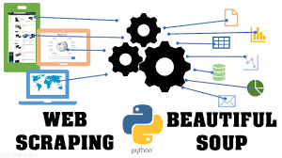
Web-Scraping
BeautifulSoup
Navigated to URL and scraped article contents
Quarterly company market cap values
ChromeDriver
Yahoo finance for historical data

Slide 5
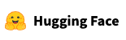

NLP
HuggingFace API (distilRoberta-financial-sentiment)
Version of the distilroberta-base model fine-tuned on financial phrases
Self-supervised transformers model
No human labeling
6 layers, 768 dimension and 12 heads, totalizing 82M parameters

Slide 6
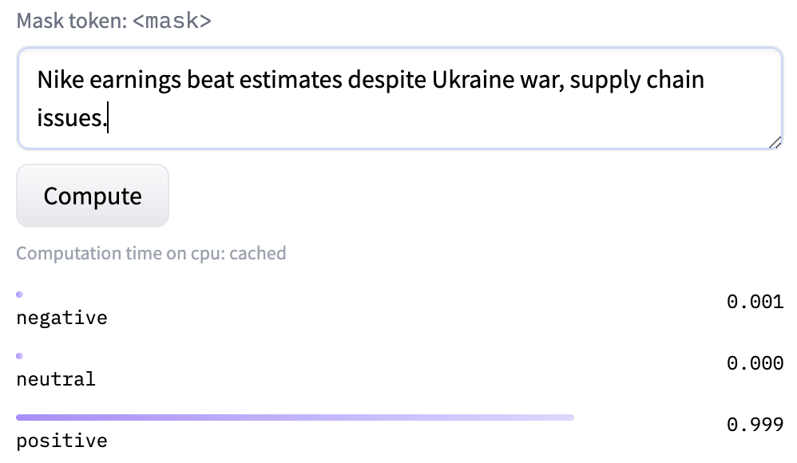
NLP Process
After web-scraping article contents…..
Sentence by sentence
Outputs
Positive
Negative
Neutral
Collect summary statistics of all sentences for each output score
Minimum
Maximum
Median
Mean

Slide 7

Next Steps
Readability scores
Smjsindustry or TextDescriptives
Tag articles with companies/stocks
FuzzyWuzzy
Merge historical stock prices with sentiment and readability scores
Develop predictive model using sentiment scores, readability scores, and market caps as features to predict stock daily price movement

Slide 8
Challenges
Dirty data
Different formats
Dead URLs
Web-scraping & HuggingFace API
Scalability
Google Colab & ACCRE issues
AWS EC2?

Slide 9

Questions?

